Slide 1
Module 4 - Two - Dimensional Viewing and Clipping
By Poonam Pangarkar
Department of CSE Data Science Engineering APSIT

Slide 2
Window and Viewport
The method of selecting and enlarging a portion of a drawing is called windowing. The area chosen for this display is called a window. The window is selected by world-coordinate.
Sometimes we are interested in some portion of the object and not in full object. So we will decide on an imaginary box. This box will enclose desired or interested area of the object.
Such an imaginary box is called a window.
An area on a display device to which a window is mapped a viewport.

Slide 3
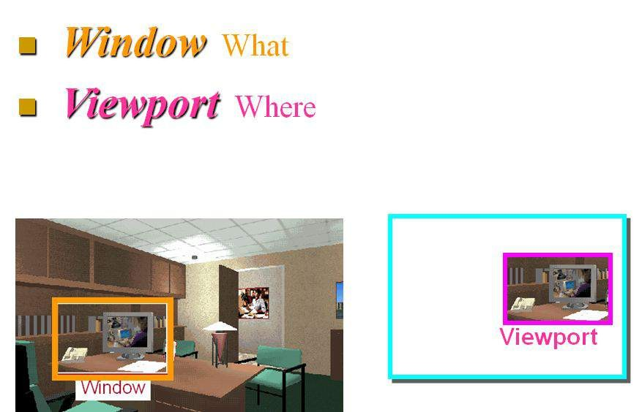

Slide 4
World Coordinates
It is logical to use dimensions which are appropriate to the object e.g.
meters for buildings
nanometers or microns for molecules, cells, atoms
light years for astronomy
The objects are described with respect to their actual physical size in the real world, and then mapped onto screen coordinates.

Slide 5
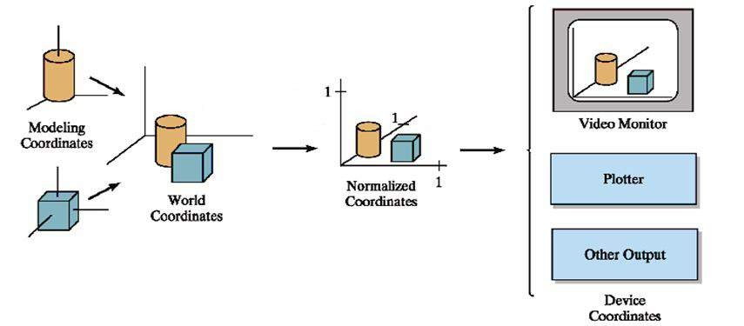

Slide 6
Viewing Transformation Pipeline
A series of transformations, which are passed by geometry data to end up as image data being displayed on a device.
For a 2D picture, a view is selected by specifying a subarea of the total picture area.
Any conventional cartesian coordinate system, referred to as the world coordinate reference frame can be used to define the picture.
Mapping of a part of a world coordinate scene to device coordinate is referred to as viewing transformation or window to viewport transformation or windowing transformation.

Slide 7
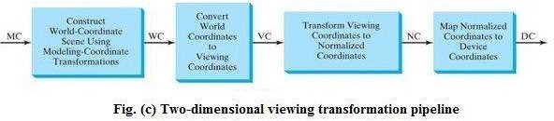
Coordinate Transformation

Slide 8
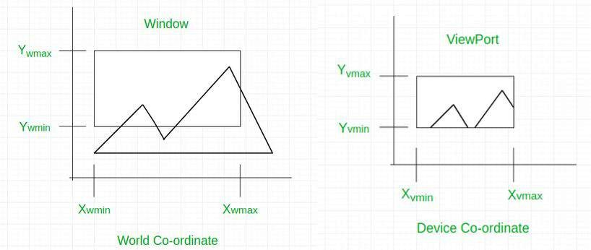
A world coordinate area selected for display is called a Window. World coordinate is the Cartesian coordinate w.r.t which we define the diagram, like Xwmin, Xwmax, Ywmin, Ywmax.
An area on a display device to which a window is mapped is called a Viewport. Device Coordinate is the screen coordinate where the objects are to be displayed, like Xvmin, Xvmax, Yvmin, Yvmax.

Slide 9
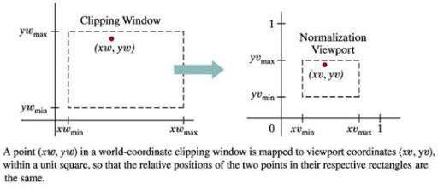
Window to Viewport Coordinate Transformation
(May 18 and May 19 5 Marks)

Slide 10
Window to Viewport Coordinate Transformation
It may be possible that the size of the Viewport is much smaller or greater than the Window.
In these cases, we have to increase or decrease the size of the Window according to the Viewport and for this, we need some mathematical calculations.
(xw, yw): A point on Window
(xv, yv): Corresponding point on Viewport
we have to calculate the point (xv, yv)

Slide 11
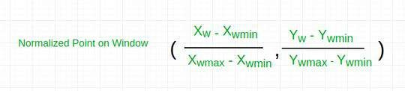
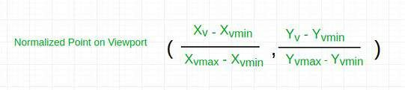
Window to Viewport Coordinate Transformation
Now the relative position of the object in Window and Viewport are same. So , we can equate them and calculate Xv, Yv.

Slide 12
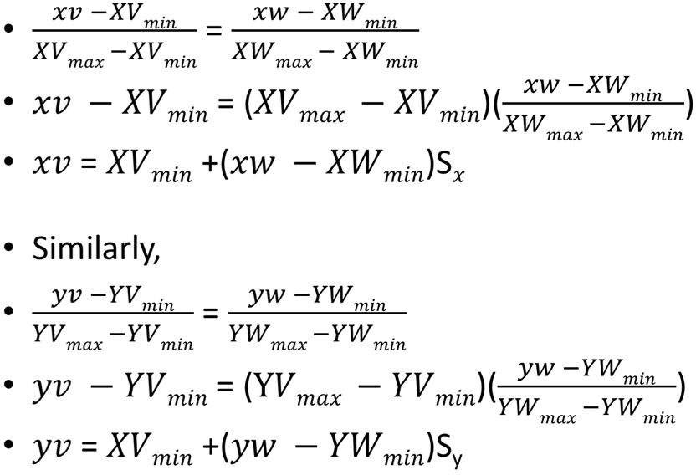
YVmin

Slide 13
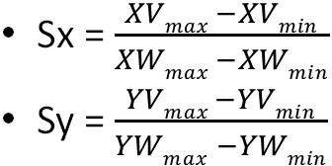
Scaling factor in x is defined as the width of viewport / width of window
Scaling factor in y is defined as the height of viewport / height of window

Slide 14
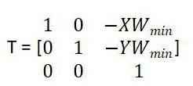
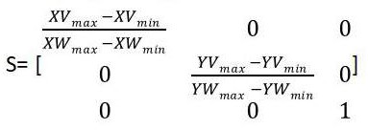

Matrix Representation
Window to viewport transformation is achieved by the following three transformation steps:
Translate the lower-left point of window to the origin.
Apply scaling to map the scene to the viewport.
Inverse Translation in the viewport.

Slide 15
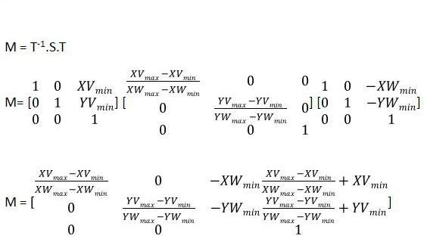
The composite transformation for the window to viewport transformation is given as,

Slide 16
Clipping
The portion left outside the region of the window in computer graphics is called the clipped part and the process of displaying the inside image of the windows is called clipping.
A graphics package allows a user to specify which part of a defined picture is to be displayed and where that part is to be displayed on the display device using a concept known as clipping.
It is a procedure that identifies those portions of a picture that are either inside or outside of a specified region of space.

Slide 17
Types of Clipping
Point Clipping
Line Clipping
Cohen Sutherland
Cyrus Beck
Liang Barsky
Polygon Clipping
Sutherland - Hodgeman
Weiler - Atherton
Text Clipping
All or none string
All or none character
Individual character

Slide 18
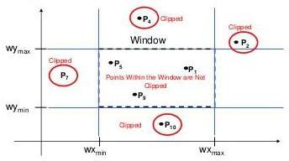
Point Clipping
Remove those points that are outside the window.
A point P(x,y) is displayed iff:
○
○
^{x}min ^{≤ x ≤ x}max ^{y}min ^{≤ y ≤ y}max

Slide 19
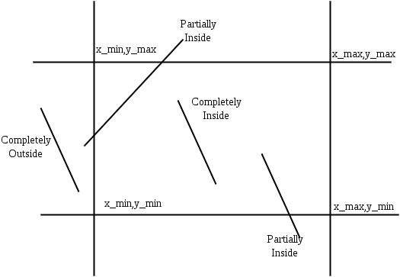
Line Clipping
Removes the line or the part of line that lies outside the clipping window.
Types of line
Visible
Not Visible
Partial Visible

Slide 20
Cohen-Sutherland Line Clipping Algorithm
Divides a screen into 9 region.
Region code is assigned in every region, which is define by the location of the point lies in screen.
Region code is of 4-bit having 0 or 1
Window region is always 0000.
TBRL (Top, Bottom, Right, Left)
To verify the position of a specific point (x,y)
x < x_{min} → Left of the window
x > x_{max} → Right of the window
y < y_{min} → Bottom of the window
y > y_{max} → Top of the window

Slide 21
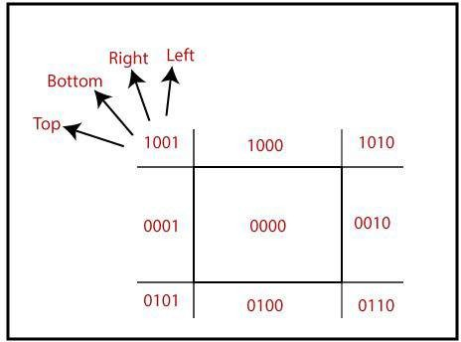

Slide 22
Conditions Case I:
Bitwise OR of region of 2 endpoints of line = 0000 → Line lies inside the window
Case II :
Bitwise OR ≠ 0000
Completely invisible
Partially Visible Bitwise AND ≠ 0000
Completely invisible
Case III :
Partially Visible
Choose the endpoints of the line.
Find the intersection point with the window.
Replace the endpoints with the intersection point.

Slide 23
Algorithm
Step 1: Assign a region code for each end point.
Step 2: Perform Bitwise OR = 0000.
Accept line & draw
Step 3: Perform Bitwise AND
If result ≠ 0000 then reject the line. else clip the line
→ Select the endpoints.
→ Find the intersection point at the window.
→ Replace endpoints with the intersection pt & update the region code.

Slide 24

Equations for intersection
Slope of line
y₂ - y₁ = m(x₂ - x₁)
y₂ = y₁ + m(x₂ - x₁)
x₂ - x₁ = 1/m (y₂ - y₁)
x₂ = x₁ + 1/m (y₂ - y₁)

Slide 25
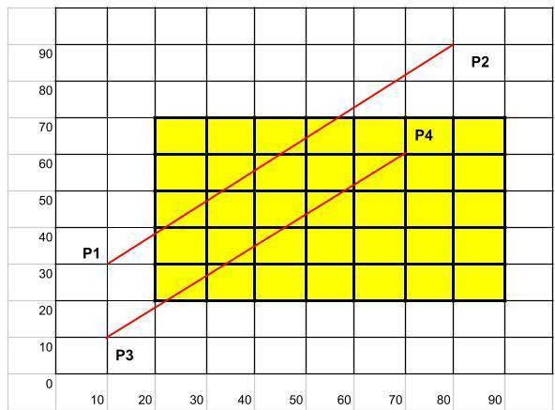
Numerical
1) Let ABCD be the rectangle window A(20,20) B(90,20) C(90,70) & D(20,70). Find region codes for the endpoint to clip the P₁P₂ with P₁(10,30) P₂(80,90) and P₃P₄ with P₃(10,10) P₄(70,60).
Sol^{n}:
Line P₁P₂
Finding region code of P₁P₂
P₁ = 0001
P₂ = 1000
AND = 0000
∴ that means line is partially visible So it needs clipping
Slope m = Δy/Δx = 6/7 = 0.857

Slide 26
For P₁’(20,y)
∴ y = m ( x - x₁ ) + y₁
= 0.857(20-10) + 30 = 38.58
P₁’ = (20,39)
For P₂’(x,70)
∴ x = 1/m ( y - y₁ ) + x₁
= 56.67
P₂’ = (57,70)

Slide 27
Line P₃P₄
P₄ lies in the window since its region code is 0000
∴ The coordinates of P₄ will remain unchanged.
∴ New line will be P₃’ P₄ as [(21.2,20) , (70,60)]
P = 0101
3
P₄ = 0000
AND = 0000
Slope m = Δy/Δx = 0.833
For P₃’(x, 20)
x = 1/m ( y - y₁ ) + x₁
= 1\0.83 (20 - 10) + 10
= 21.20
P₃’ = (21.2, 20)

Slide 28
Clip the line PQ having coordinates P(4,1) Q(6,4) against the clip window having vertices A(3,2) B(7,2) C(7,6) D(3,6) using cohen sutherland line clipping algorithm. (Dec 18 10 Marks)
Let R be the rectangular window whose lower left-hand corner at L(-3,1) & upper right corner is at R(2,6). Find the region codes for the endpoints & use
cohen sutherland segments are
AB - A(-4,2) B(-1,7)
CD - C(-1,5) D(3,8)
EF - E(-2,3) F(1,2)
algorithm to clip the line segments coordinate for line
4) Use Cohen-Sutherland algorithm to clip two lines P1(40,15) P2(75,45) and P3(70,20)P4(100,10) against a window A(50,10), B(80,10), C(80,40) and D(50,40)

Slide 29
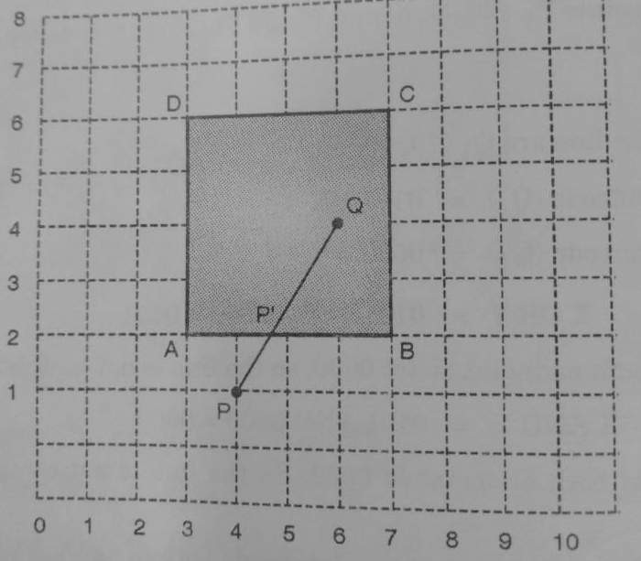
Solution:
2) Clip the line PQ having coordinates P(4,1) Q(6,4) against the clip window having vertices A(3,2) B(7,2) D(3,6) C(7,6) using cohen sutherland line clipping algorithm. (Dec 18 10 Marks)
Region code for P = 0100 Region code for Q = 0000 P OR Q = 0100
P AND Q = 0000
m = 1.5
Intersection (x , 2) = P3’
x₂ = x₁ + 1/m (y₂ - y₁) x = 4 + 1/1.5 (2 - 1)
x = 4.67
Visible Line Segment = (4.67, 2) to (6,4)

Slide 30
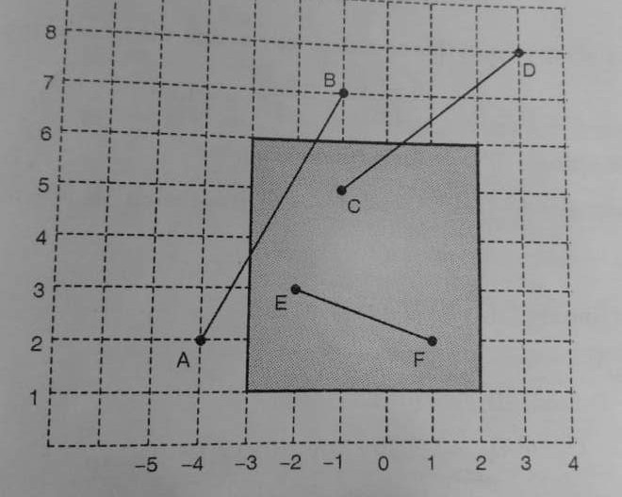
3) Let R be the rectangular window whose lower left-hand corner at L(-3,1) & upper right corner is at R(2,6). Find the region codes for the endpoints & use cohen sutherland algorithm to clip the line segments coordinate for line segments are
AB - A(-4,2) B(-1,7)
CD - C(-1,5) D(3,8)
EF - E(-2,3) F(1,2)
Solution:
LINE AB
A - 0001
B - 1000
A OR B - 1001 A AND B - 0000 M = 5/3= 1.67 A’ (-3,y)
y₂ = y₁ + m(x₂ - x₁)=3.67 B’(x,6)
x₂ = x₁ + 1/m (y₂ - y₁) = -1.60
Visible Segment (-3,3.67) to (-1.6, 6)

Slide 31
LINE CD C - 0000
D -1010
LINE EF E - 0000
F - 0000
C OR D - 1010 C AND D - 0000
Slope = 8-5/3+1=¾=0.75 Intersection (x,6)
x₂ = x₁ + 1/m (y₂ - y₁) = 0.33
Visible Line Segment (0.33,6) to (-1,5)
E OR F - 0000
Line is completely inside
Visible Segment (-2,3) to (1,2)

Slide 32
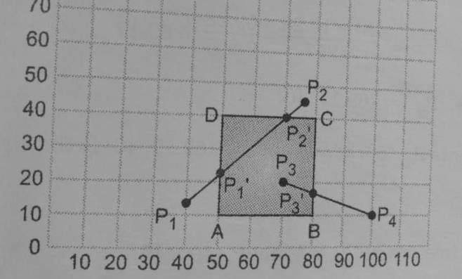
4) Use Cohen-Sutherland algorithm to clip two lines P1(40,15) P2(75,45) and P3(70,20)P4(100,10) against a window A(50,10), B(80,10), C(80,40) and D(50,40)
Region code for P1=0001 Region code for P2=1000 P1 OR P2 = 1001
P1 AND P2 = 0000
Line P1P2
Intersection point (50, y)
y₂ = y₁ + m(x₂ - x₁) y = 23.57
(50, 23.57)

